Slide 1
“Food Delivery Website and Application”
Task - 1

Slide 2
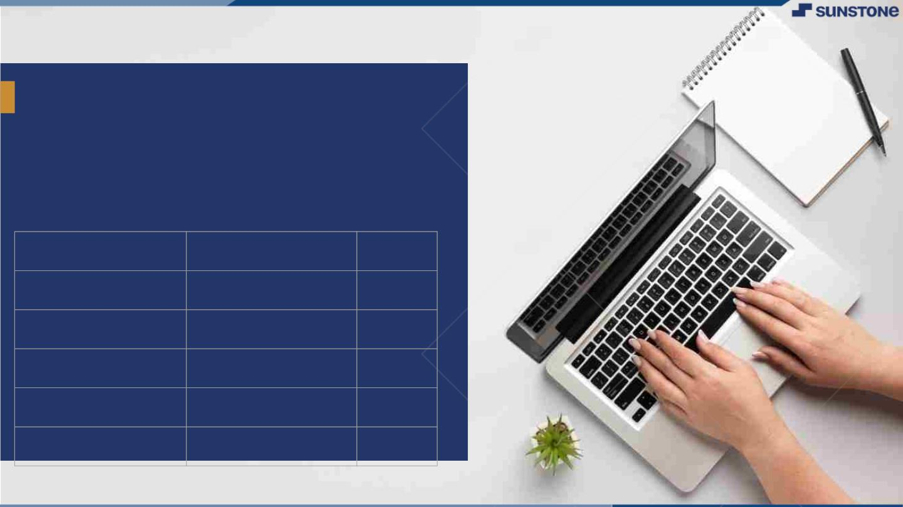
Food Delivery
Website and Application
▪
Food delivery apps are a type of restaurant delivery/ takeout software that connects consumers with local restaurants, grocery stores, convenience stores, etc., by providing a convenient way to order food that's delivered to their doorstep..
LMS Username
Name
Batch
au420420205013
Jayalakshmi
CA2
au420420205006
Nandhini
CA2
au420420205017
Divyadharshini
CA2
au420420205020
Priyadharshini
CA2

Slide 3
Task 3 :: Frontend Creation
Create various Front End Programs
Draw and design a uniform front end code for “Your Project”
Draw and design a interactive front end code for “Your Project”
Evaluation Metric:
100% Completion of the above tasks
Learning outcome
Developing complicated UI using HTML components
Using props drilling and context to pass variables
Getting familiar with different type of api calls
Handling different input data

Slide 4

Step-Wise Description
1). Creating a HTML structure.
2). React – a java library for building a user interface.
3). Chakraui – A Simple, Modular and accessible component library that gives the building blocks to build react applications.
4). Redux – A predictable state Container for Javascript apps.
5). Building a pages that includes Auth, Comment Page, Profile Page, Edit Profile page, Home page, Routers and Story page.
6). Building a components such as Comment, Create, Demo, Edit Profile Component, Home right, Post, Profile page card, Register, Search Components, Sidebar and Story.
7). Configuring a javascript apps includes Debounce, Logic, Uploadtocloudinary.
Summary of your task
Welcome to SavorySwift, where convenience meets culinary delight! Our food delivery website and app are designed to revolutionize the way you experience meals. Say goodbye to long queues and tedious cooking, and embrace a world of flavors delivered right to your doorstep.

Slide 5
Assessment Parameter
Create folder structure for HTML application
Render Conditional components
Write Functions for event handling
Check-List
Overall UI of the project
Handling broken links
Optimizing render cycle

Slide 6
Submission Github
https://github.com/Jayalakshmi77/Food-Delivery-Website.git

